Slide 1
CPU-cachen og deg: Hvordan skrive cache-effektiv kode
Rune Holm
Oslohack:22
https://github.com/runehol/cache_efficiency_talk

Slide 2
Intro
The basic concept of caches is simple enough – small, recently used data are more quickly accessed
But there are many compromises in actual implementations that show up
We’ll look at these in practice using a Raspberry Pi3B+ - a fairly standard low-end Arm system with 4 Cortex-A53 CPUs
A cache efficiency talk, not a SIMD talk - the examples have been set up to not vectorise. SIMD is big enough for a separate topic
An interactive talk - I’ll ask you what you think will happen at various times – respond when this happens

Slide 3
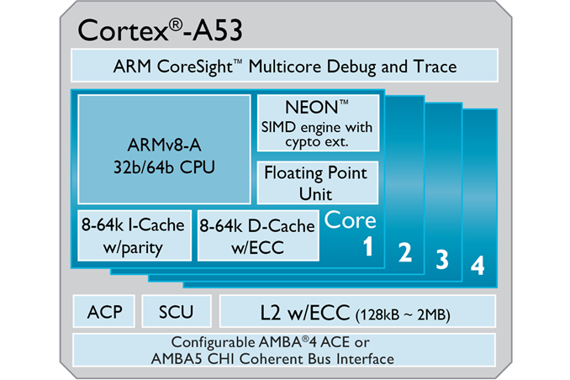
CPU cache hierarchy – Raspberry Pi 3B
Cache | Size | Bandwidth | Latency
L1 data cache | 32 KB | 12 GB/s? | 3 cycles
L2 unified cache | 512 KB | 12 GB/s? | 16 cycles
DRAM | 1 GB | 1 GB/s | ~200 cycles
32 KB
32 KB
512 KB

Slide 4
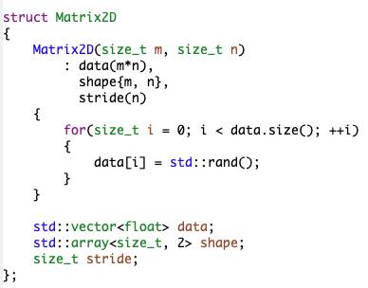
Data manipulation in this talk
We’ll work over Matrix2Ds of float stored in linear layout, tightly packed
Not meant to be an example of best encapsulation practices – it’s just easier to reason about performance if you can see the actual implementation ☺
Now on to the first example – summing the matrix contents!

Slide 5
Line size
Cortex-A53 L1D
Address | Data
Line 0: 0x04352000 | 64 bytes
Line 1: 0x0341C000 | 64 bytes
Line 2: 0x01238000 | 64 bytes
Line 3: 0x0124A000 | 64 bytes
Line 4: 0x12312040 | 64 bytes
Line 5: 0x5436A040 | 64 bytes
Line 6: 0xBC45E040 | 64 bytes
Line 7: 0x43540040 | 64 bytes
… | 64 bytes
… | 64 bytes
… | 64 bytes
Line 511: 0x42151FC0 | 64 bytes
line = address & ~0x3F
It’s too expensive to remember addresses for individual bytes in a cache
Caches are therefore organised into lines
In this and many other designs, the lines are 64 bytes each
If you load one byte, you get its 63 closest friends for free
Therefore, prefer low-strided accesses and data structures that keep data used together close by

Slide 6
Set associativity
set = (address & 0x1FC0)>>6
Cortex-A53 L1D
Set | Address | Data
Set 0 | Line 0: 0x04352000 | 64 bytes
 | Line 1: 0x0341C000 | 64 bytes
 | Line 2: 0x01238000 | 64 bytes
 | Line 3: 0x0124A000 | 64 bytes
Set 1 | Line 4: 0x12312040 | 64 bytes
 | Line 5: 0x5436A040 | 64 bytes
 | Line 6: 0xBC45E040 | 64 bytes
 | Line 7: 0x43540040 | 64 bytes
Set 127 | … | 64 bytes
 | … | 64 bytes
 | … | 64 bytes
 | Line 511: 0x42151FC0 | 64 bytes
It’s too expensive to look at all 512 lines to find an address
Lines are therefore divided into sets, usually indexed by the next-to-last bits of the address
Cortex-A53:
L1D: 4-way set associative
L2: 16-way set associative
If you have to do large strided accesses, avoid powers–of-two strides
And don’t plan to fill caches to the brim. Rules of thumb:
L1: 50% max occupancy
L2: 75% max occupancy

Slide 7
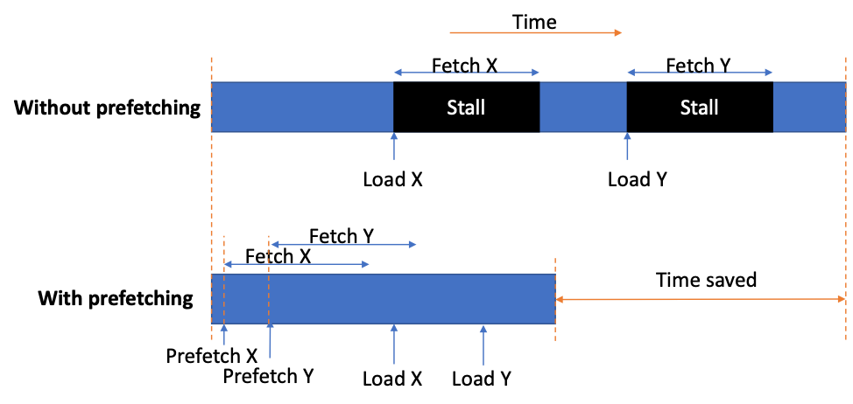
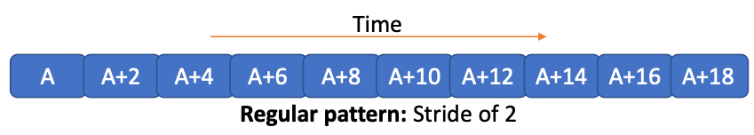
Prefetcher
Cache | Size | Bandwidth | Latency
L1 data cache | 32 KB | 12 GB/s? | 3 cycles
L2 unified cache | 512 KB | 12 GB/s? | 16 cycles
DRAM | 1 GB | 1 GB/s | ~200 cycles
CPUs come with prefetchers that monitor address patterns accessed
If it spots accesses with regular strides, it can start fetching the next cache lines before the CPU hits the load instructions requesting them
Until now, we’ve had access patterns the prefetcher understands, and been bandwidth limited
But without predictable patterns, we become latency limited

Slide 8
Matrix transpose
A | B | C | D
E | F | G | H
I | J | K | L
M | N | O | P
Q | R | S | T
Sometimes it isn’t easy to avoid high-strided accesses
For a matrix transpose, either we access the source or the destination matrix with high strides
But maybe there are things we can do?
A | E | I | M | Q
B | F | J | N | R
C | G | K | O | S
D | H | L | P | T

Slide 9
One final mystery – why does DRAM speed vary?
In the preceding tests, we’ve seen wildly varying DRAM speeds
We have less variation if we consider bandwidth amplification
If we ask for 4 bytes, and the cache line isn’t present in L1 or L2, the cache system will go and fetch 64 bytes instead of 4 bytes from DRAM
But there’s still a factor 3 difference
Test | Ordered bandwidth | Bandwidth amplification | Actual bandwidth
benchmark_sum_inner_to_outer/1000/1000 | 1080 MB/s | 64/64 | 1080 MB/s
benchmark_sum_outer_to_inner/1000/1024 | 22.5 MB/s | 64/4 | 360 MB/s
benchmark_sum_random/1000/1000 | 42.5 MB/s | 64/4 | 680 MB/s
benchmark_sum_random/10000/1000 | 21 MB/s | 64/4 | 336 MB/s

Slide 10
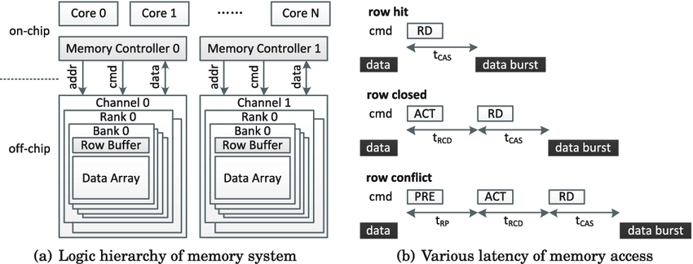
How does DRAM work?
Cannot access random locations at full speed
Instead, DRAM is split into one or more memory controllers, divided into multiple banks, and each bank can hold a page (few KB) in the row buffer for modification
To access a new page, the new page must be loaded into the row buffer
Switching between reads and writes also costs – DRAM controllers tend to have buffering of requests to get consecutive reads to the same page and writes to the same page

Slide 11
How does DRAM work?
Best access pattern: Sequential accesses to the same page, either all reads or all writes
Worst access pattern: random addresses, mix of reads and writes
Rule of thumb: Best memory access pattern to worst memory access pattern: 3x difference
Test | Ordered bandwidth | Bandwidth amplification | Actual bandwidth | Efficiency
benchmark_sum_inner_to_outer/1000/1000 | 1080 MB/s | 64/64 | 1080 MB/s | 100%
benchmark_sum_outer_to_inner/1000/1024 | 22.5 MB/s | 64/4 | 360 MB/s | 33%
benchmark_sum_random/1000/1000 | 42.5 MB/s | 64/4 | 680 MB/s | 63%
benchmark_sum_random/10000/1000 | 21 MB/s | 64/4 | 336 MB/s | 31%

Slide 12
Summary
Design data structures so data used together are in the same cache line
If this is not possible, prefer regular strides so the prefetcher can help you
But avoid high powers-of-two strides as to not get caught out by set associativity
Consider blocking if the problem allows for it
Find the talk slides and code at https://github.com/runehol/cache_efficiency_talk

